Slide 1
CEF 440
INTERNET AND MOBILE PROGRAMMING

Slide 2
Food Waste Management System

Slide 3
TABLE OF CONTENT
INTRODUCTION
REQUIREMENTS
ANALYSIS OF REQUIREMENTS

Slide 4
INTRODUCTION
Due to the increase in the amount of food stuffs wastage in our society, a platform which aim is to permit those who have food stuffs and who are no longer in need to upload to this platform either freely or at a discount price appeared as a solution.

Slide 5
REQUIREMENTS
Requirements are divided into
Functional Requirements
Non-Functional Requirements

Slide 6
FUNCTIONAL REQUIREMENTS

Slide 7
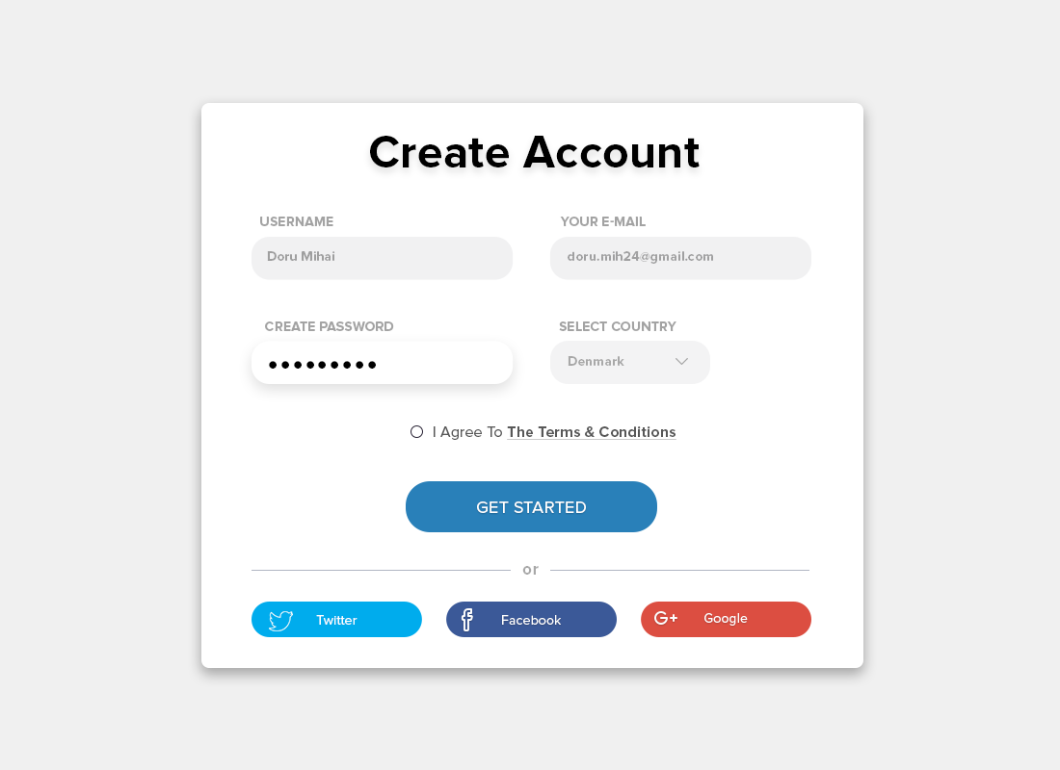
CREATE AN ACCOUNT
Users should be capable of creating an account in the platform

Slide 8
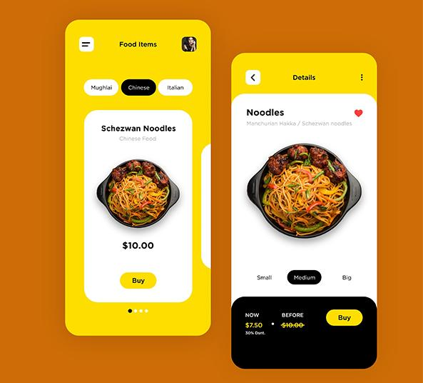
POST FOOD
Users should be capable of posting the food they have for other users to see it.

Slide 9

Contact the person offering food
A user needing help should be able to contact the person offering food after validation

Slide 10

SEARCH FOOD
Users should be capable of searching for a particular type of food either cooked or uncooked.

Slide 11

NOTIFICATIONS
Users should be able to Receive Notifications on latest uploads.

Slide 12

FORUM
Here, users can discuss among them.

Slide 13

Localisation
This is used to know the location of users.

Slide 14
NON-FUNCTIONAL REQUIREMENTS

Slide 15
Reliability
Availability
Security
Maintainability
Portability
Scalability

Slide 16
ANALYSIS OF REQUIREMENTS

Slide 17








Context Diagram
System administration
Authentication service
Notifications
Sercure Authentication sytem
Search
KYC
Notify
Update
FWA
Outlines how external entities interact with an internal system
Evaluate
Post
search
User, admin, post informations
Database
user

Slide 18
Use diagrams to explain your ideas
User login
Posting food
Purpose
User logs in to system using existing profile
User wants to let others know he has available food
Invariant
Profile table data and user information.
The post cannot be modified
User
A user with an existing profile
A legitimate(KYC checked) user that is logged into the system
Inputs and Output data
Profile username and password/corresponding page data
Picture Of the food, Nature ( cooked or uncooked ), Location, Quantity /Post shared to other users
Pre-Conditions
User is not logged in to a profile, input
profile exists in data base, user
password matches profile
User is Logged in and verified through KYC
Post-Conditions
User's computer has been supplied
with appropriate cookie, page data is
appropriate for selected profile
Any person in the same locality should be notified of the post and be able to register for the donation
LOREM

Slide 19
Use case senario Study
Rating, Discussion and Comments
Search Result
Purpose
User Discuss with other users of the system, takes rendezvous with food donors and sellers, comment posts and also rate their quality of Service
User wants to search for a particular meal
Invariant
The message sent cannot be modified but can be deleted
The user and the search result
User
A user that is logged into the system
Any logged in user
Inputs and Output data
Message to be sent /Message send to targeted user or set of users
Name of meal, Filter by Category or Location/ All the corresponding posts
Pre-Conditions
User is Logged into the system
User is Logged in
Post-Conditions
The person(s) to whom the message is destined to should be the only ones to be able to view its content
Search result should be precise, explicit and usable
LOREM

Slide 20
Use diagrams to explain your ideas
Notification
Purpose
To get Notifications of posts of foods you like the most, and permanent notifications for post monitoring
Invariant
Notification Content
User
Any User of the system
Inputs and Output data
The Notification/ Notification content
Pre-Conditions
User has an account in the system and have granted notification permission to the app
Post-Conditions
User receives only desired notifications
LOREM

Slide 21
CONCLUSION:
From the above analysis, we can conclude that a Food Waste Management System is one the optimal solution in order to solve food stuff wastage.

Slide 22


Thanks!

Slide 23
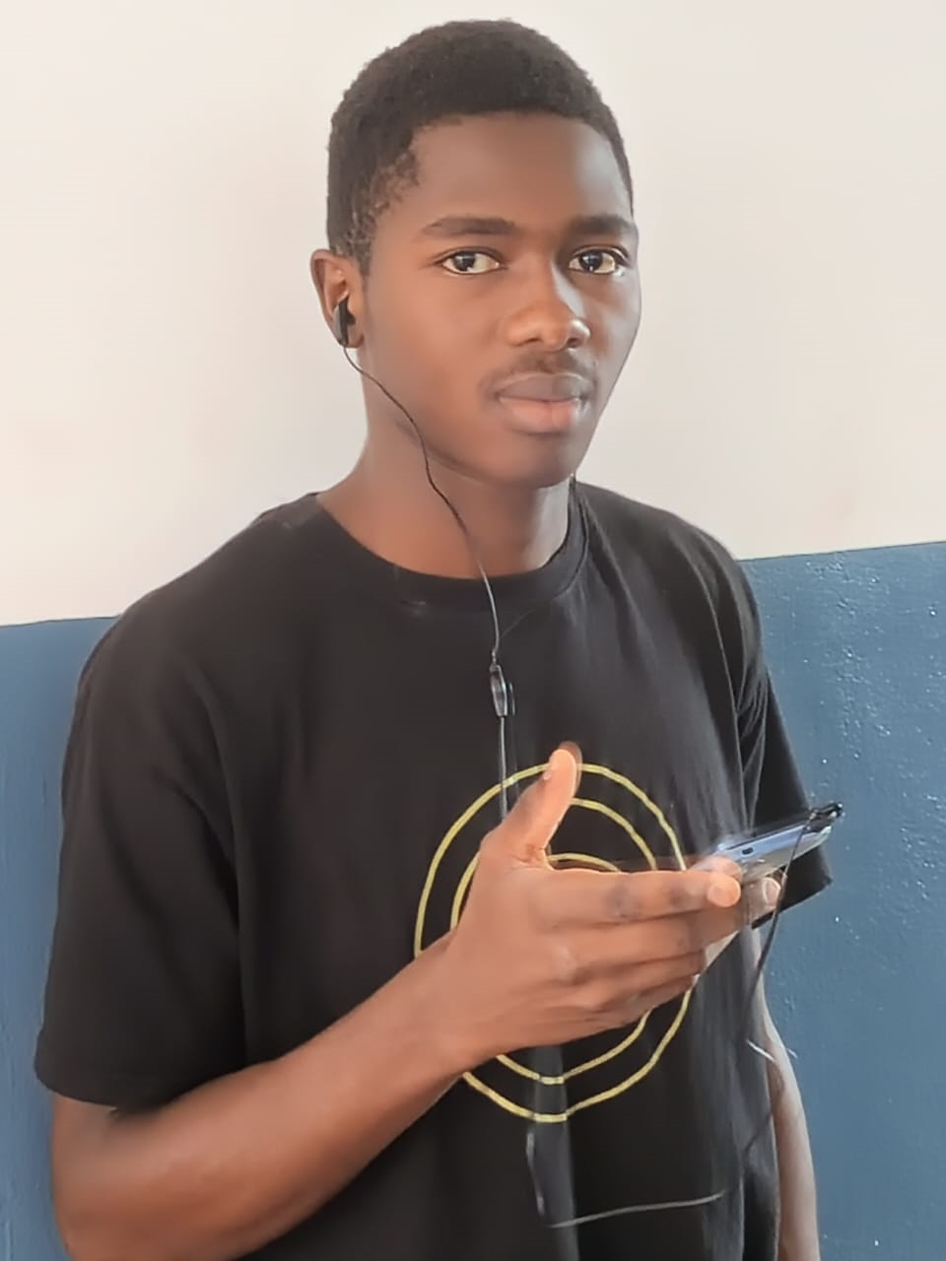
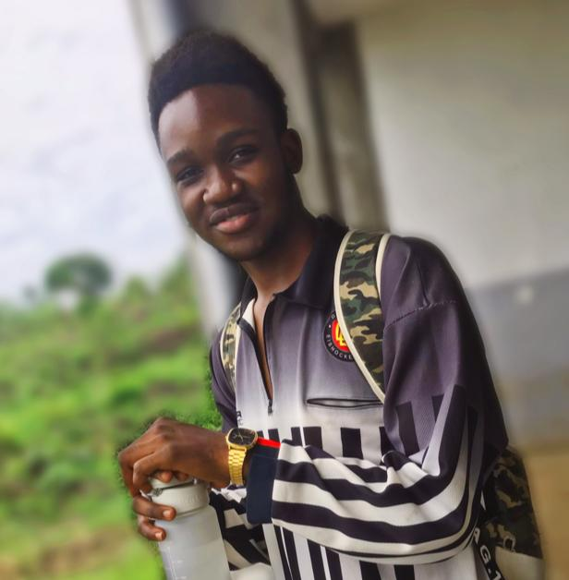
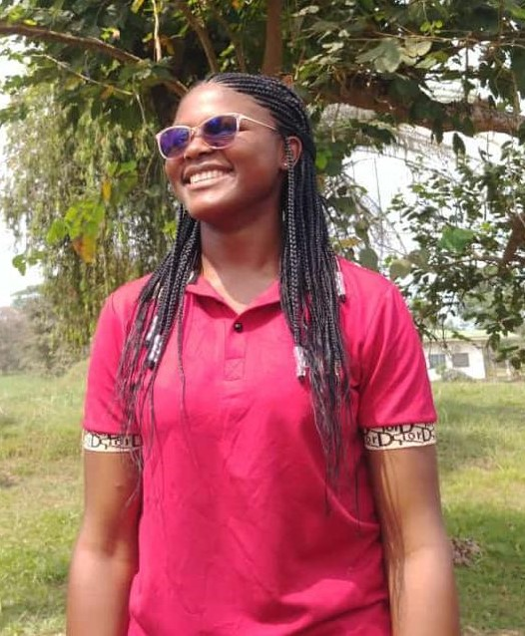
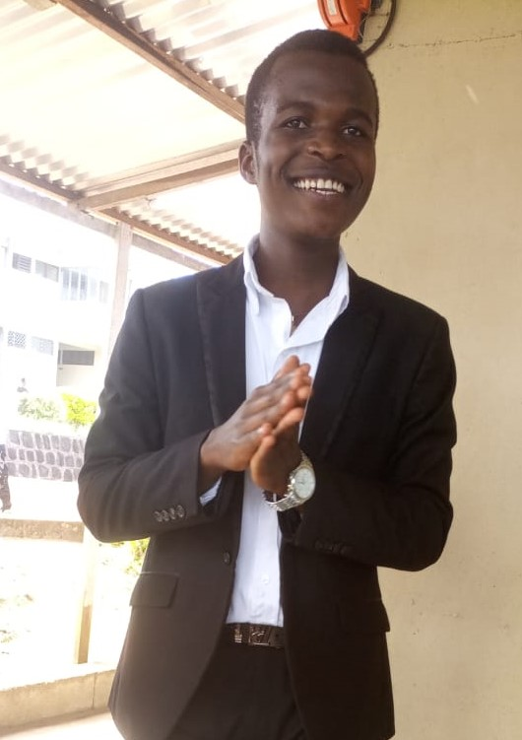
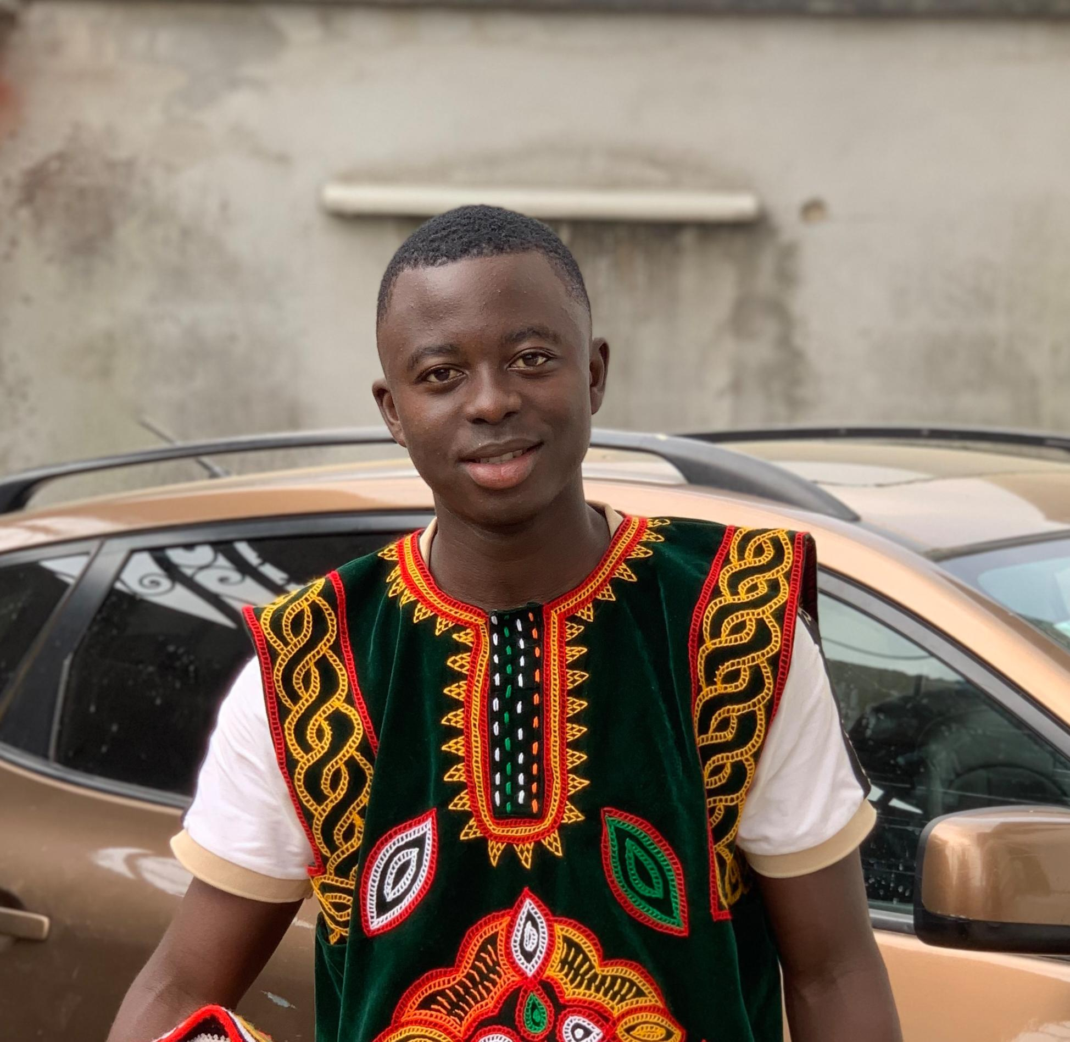
Team Presentation Group 1
DJIOTSA Christian
BITO’O Dylan
MADADJO Monick
DJOUKENG Ivan
CHEZEM Miguel

